Slide 1
Marco the DREAMer

Slide 2
My story
I’m stuck on a rock… how do I come down?
Alone in the wilderness
Fire, a long way to go

Slide 3
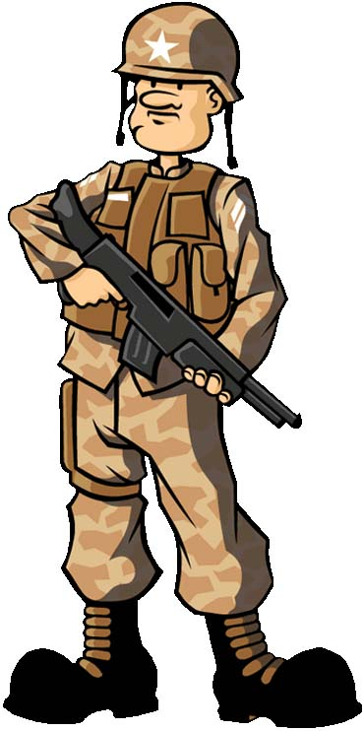
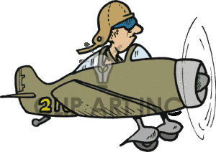
MY STORY
My name’s Marco and I was born in Verona, a lovely city from Italy. So it happened that one day I was chosen for an important mission in Odessa, Ukraine, because of my military training. I had to fly the plane all by myself.

Slide 4
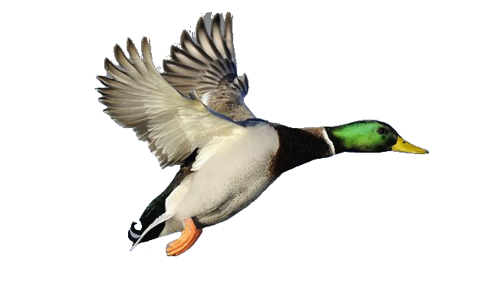
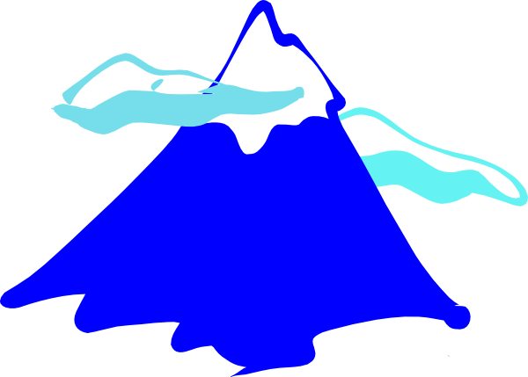
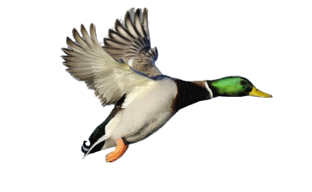
Everything was going just fine, until I saw a flock of wild ducks heading towards me. I didn’t even have time to think- I took a wrong turn and heard the crash. The wing had hit a rock and I lost control of the plane.

Slide 5
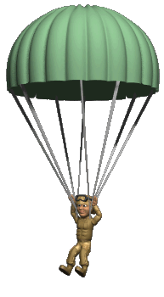
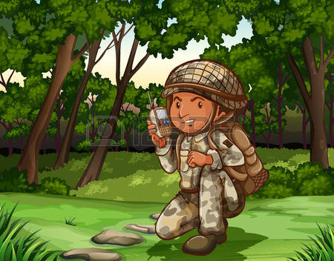
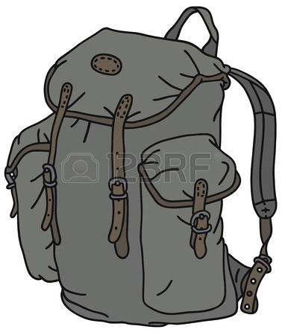
I quickly grabbed my small emergency backpack and the parachute and I escaped, jumping right before the plane crashed on the top of the mountain. I, however, was stuck up there, on a rock. From here on, I made use of my knowledge of Physics, and, obviously, of the things I knew from Maths.

Slide 6

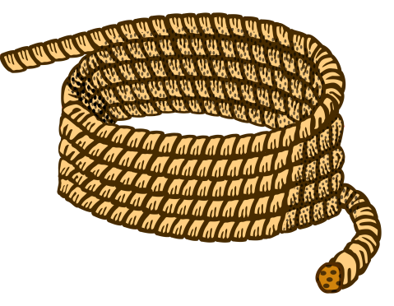
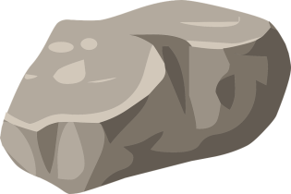
I’m stuck on a rock…how do I come down?
I found myself at a big distance from the ground, so I had to use the rope I had in my backpack. To make sure that it was going to hold me, I used the ‘equilibrium of forces’.
I decided to tie my rope, which was 50m long, around a stone and throw it down, to figure out the distance to the plateau. I realized that my rope was 3m too long, so using Maths I calculated the distance to the ground: 47m.
To find out the gravitational acceleration, I threw a small rock and started the timer I had in my backpack. It took 3,19s for the rock to reach the ground, so all I had to do was use the formulas.

Slide 7

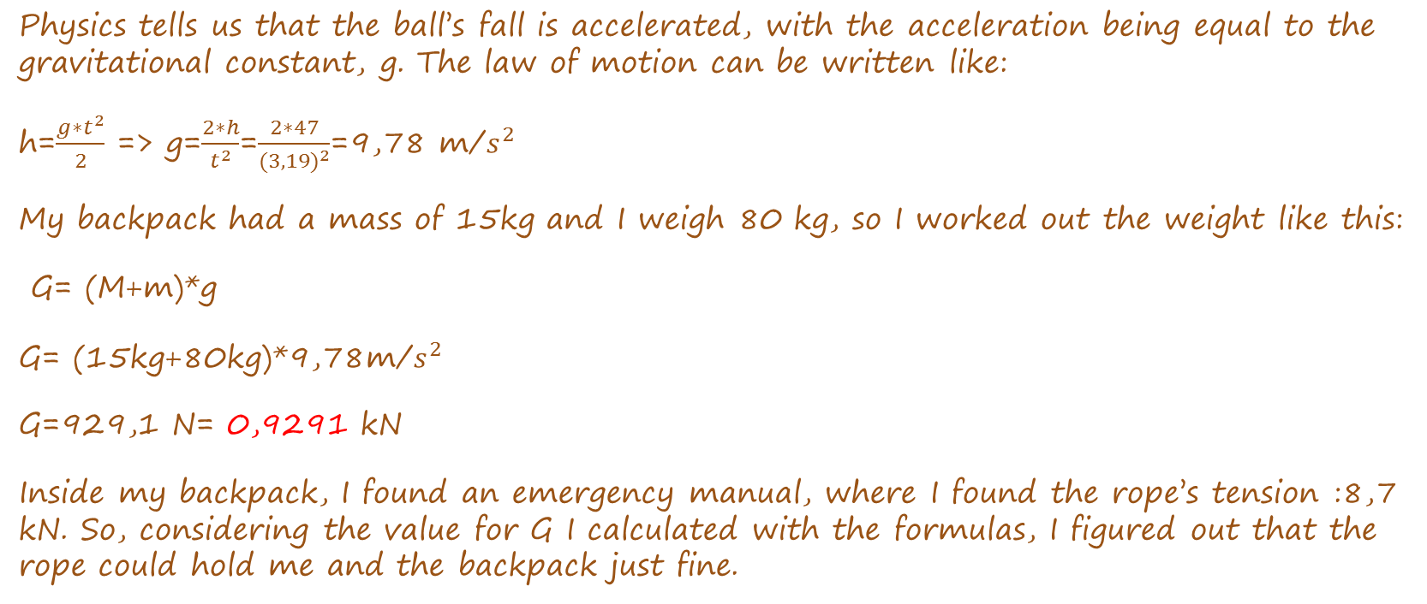
Physics tells us that the ball’s fall is accelerated, with the acceleration being equal to the gravitational constant, g. The law of motion can be written like:
h=$\frac{{g∗t}^{2}}{2}$ => g=$\frac{2∗h}{t^{2}}$=$\frac{2∗47}{{(3,19)}^{2}}$=9,78 m/$s^{2}$
My backpack had a mass of 15kg and I weigh 80 kg, so I worked out the weight like this:
G= (M+m)*g
G= (15kg+80kg)*9,78m/$s^{2}$
G=929,1 N= 0,9291 kN
Inside my backpack, I found an emergency manual, where I found the rope’s tension :8,7 kN. So, considering the value for G I calculated with the formulas, I figured out that the rope could hold me and the backpack just fine.

Slide 8
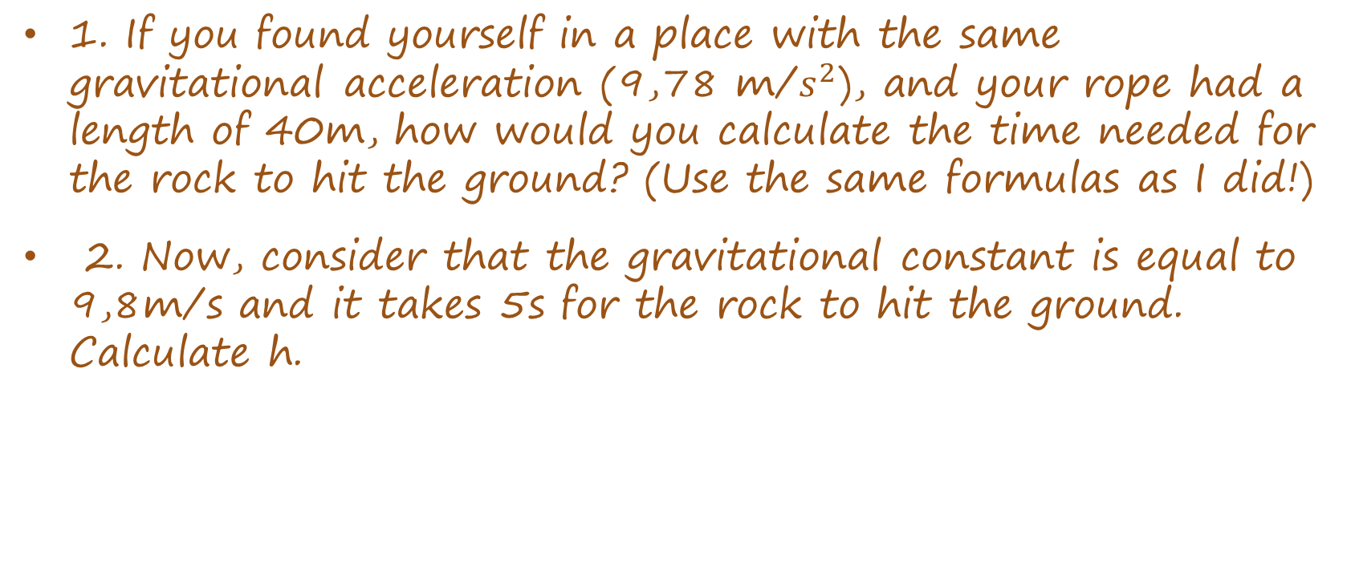
Could you have done the same thing?
1. If you found yourself in a place with the same gravitational acceleration (9,78 m/$s^{2}$), and your rope had a length of 40m, how would you calculate the time needed for the rock to hit the ground? (Use the same formulas as I did!)
2. Now, consider that the gravitational constant is equal to 9,8m/s and it takes 5s for the rock to hit the ground. Calculate h.

Slide 9
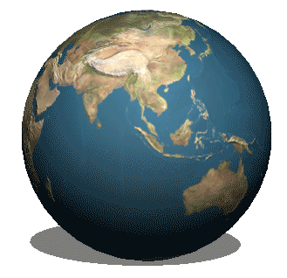
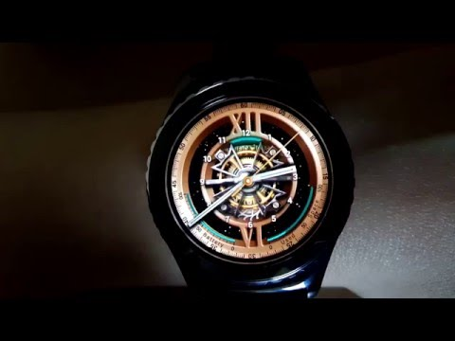
Alone in the wilderness
A huge problem was the fact that I didn’t know where exactly I had landed.
In order to find out, I used my wrist watch. Piece of cake.
I figured out that by calculating the time difference between the place where I got lost and GMT (General Mondial Time) I could calculate my longitude.

Slide 10


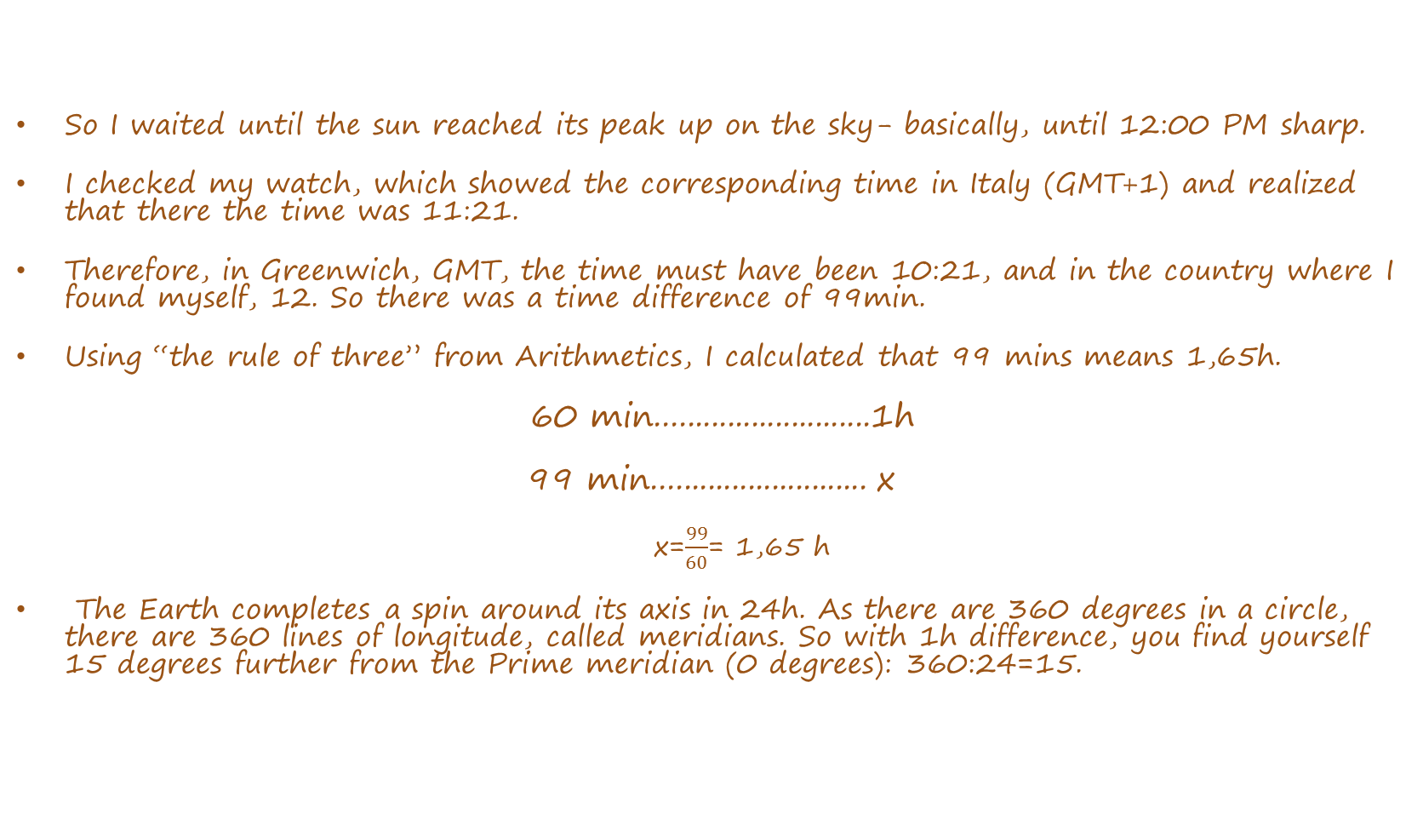
So I waited until the sun reached its peak up on the sky- basically, until 12:00 PM sharp.
I checked my watch, which showed the corresponding time in Italy (GMT+1) and realized that there the time was 11:21.
Therefore, in Greenwich, GMT, the time must have been 10:21, and in the country where I found myself, 12. So there was a time difference of 99min.
Using “the rule of three” from Arithmetics, I calculated that 99 mins means 1,65h.
60 min...........................1h
99 min........................... x
x=$\frac{99}{60}$= 1,65 h
The Earth completes a spin around its axis in 24h. As there are 360 degrees in a circle, there are 360 lines of longitude, called meridians. So with 1h difference, you find yourself 15 degrees further from the Prime meridian (0 degrees): 360:24=15.

Slide 11
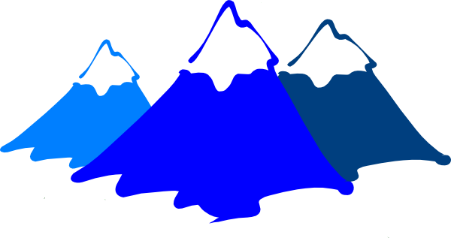
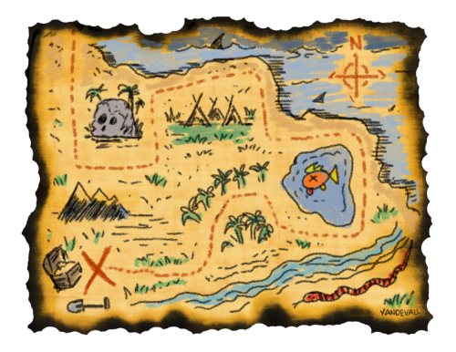
I was travelling towards Odessa, so at least I knew that I found myself in the Eastern hemisphere. I simply had to do the Maths, to find out my longitude.
If 1h difference means 15 degrees of longitude, then for the value I calculated I only had to multiply:
1,65h *15= 24,75 degrees East. – my longitude!!!
I already knew my latitude, because all the way towards Odessa I kept straight along the parallel of 45.88 degrees.
I consulted the map in my backpack and concluded that I was stuck on the Făgăraș Mountains.

Slide 12
You’re stranded!
PORTUGAL: You’re stranded on an island. When the sun is at its peak in the sky, you check your watch, showing the time in Portugal (GMT) : 9 o’clock in the morning. You know that you’re in the Eastern hemisphere. What island are you on?
GREECE : You’re stranded on an island. When the sun is at its peak in the sky, you check your watch, showing the time in Greece (GMT) : 11 o’clock in the morning. You know that you’re in the Eastern hemisphere. What island are you on? (Hint: the time difference is 3h!)

Slide 13
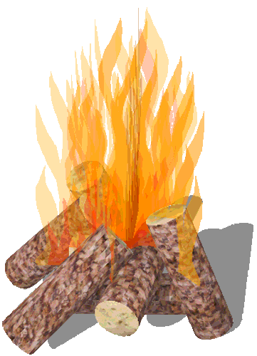
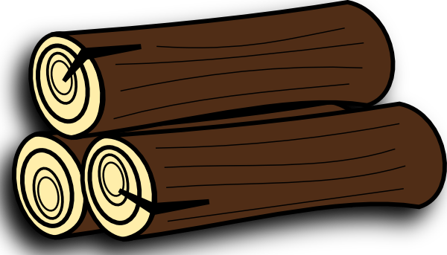
Fire, a long way to go?
After I figured out where I was, I knew I had to start a fire to warm myself and maybe make myself a warm meal and drink. But I couldn’t leave for the forest without knowing how much wood I needed for the fire. So I calculated the mass of wood I had to bring back to the place where I set up my camp.
In order to do this, I used the formulas I knew from Thermodynamics . My Aluminum bowl weighed 400g, I had 200g of water and outside, the temperature was 10 degrees Celsius. In my manual, I also found the useful tables:

Slide 14
I knew that water boils at a lower temperature, the higher you go. I searched in my manual and found that the Făgăraș Mountains are 2544m tall. There were 47m ( the length I climbed down with the help of the rope) between me and the top of the mountain, so the altitude at which I found myself was 2497m.
I found the following table in my emergency manual and figured out that at my altitude, water boiled at approximately 91 degrees Celsius :

Slide 15
Altitude - compared to Sea Level |  | Boiling Point
(ft) | (m) | (ºF) | (ºC)
-1000 | -305 | 213.9 | 101.1
0 | 0 | 212.0 | 100.0
250 | 76 | 211.5 | 99.7
750 | 229 | 210.5 | 99.2
1000 | 305 | 210.1 | 98.9
1500 | 457 | 209.1 | 98.4
1750 | 533 | 208.6 | 98.1
3000 | 914 | 206.2 | 96.8
5000 | 1524 | 202.4 | 94.7
7500 | 2286 | 197.8 | 92.1
7750 | 2362 | 197.3 | 91.8
8000 | 2438 | 196.9 | 91.6
8250 | 2515 | 196.4 | 91.3
8500 | 2591 | 196.0 | 91.1
8750 | 2667 | 195.5 | 90.8
9000 | 2743 | 195.0 | 90.6
9250 | 2819 | 194.6 | 90.3

Slide 16
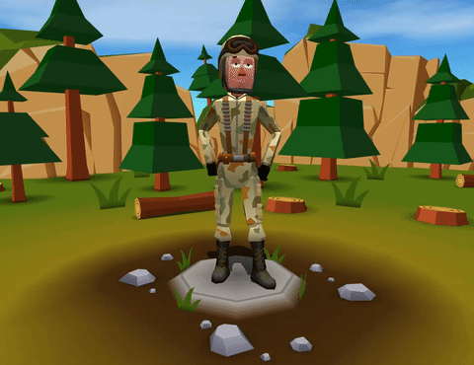
Q=m·q
Q=m·c· (tf- ti)
Q-heat
c – the specific heat of the substance
q- calorific value/heat of combustion/heating value/energy value
tf – final temperature
ti- initial temperature
Q gained=m water · c water · (tf- ti ) + m bowl · c Al · (tf- ti)
=> Q gained =97592,04 J
Q wood = m wood · q fir tree
Because of some heat loss, the total yield was of just 40%. ŋ (yield) = Q gained/Q wood =>
=> Q wood = Q gained/ŋ = 243980,1 J => m wood=56,60 Kg

Slide 17
Your turn…
Your bowl weighs m1=400g. You want to boil m2=200g of water. You gathered m3=39,03 kg of fir wood from the forest. The total yield of the heat given off by the fire is 50%. (Tip! Firstly, calculate Q fuel, in order to be able to calculate Q gained). Consider that the water boils at 100 degrees Celsius and outside, the temperature is 15 degrees Celsius.
Can you figure out from what material your bowl is made, using the previous formulas?
Use the information from the following tables:

Slide 18
I realized the weight of all the wood I had to carry was too much for me and felt the sweat running down my forehead… I couldn’t do that!!!
Suddenly, I opened my eyes and felt the warmth and comfort of my bed.
I’ve always dreamed of working in the army, but this was the weirdest dream of them all!

Slide 19
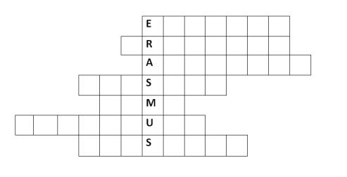
Tallest mountain in the world.
If you were to boil an egg on Everest, the boiling temperature for water would be lower, given that the atmospheric ........... is also lower.
Marco calculated the ........ at which he found himself, by subtracting from the mountain’s height the length of the rope.
The ......... of the rope is 8,7 kN.
Marco dreams of working in the .......
Marco calculated the ....... using his wrist watch.
Marco calculated the gravitational ............ to find out the total weight his rope could hold.

Slide 20
SUBSTANCE | SPECIFIC HEAT (J/Kg*K)
Brass | 384,6
Aluminium | 919,6
Silver | 250,8
Copper | 381,6
Iron | 459,8
Ice | 2090
Steel | 502,2
Lead | 125
Zinc | 399,2
Ethanol | 2482
Acetic Acid | 1736,9
Water | 4185
Acetone | 2180,6
Benzene | 1736,9
Glycerine | 2410,8
Petrol | 209
Type of wood | kJ/kg
Oak | 4,02
Fir | 4,31
Cherry tree | 4,14
Beech | 4,18
Maple | 4,20
Birch | 4,20
Locust tree | 4,18
Poplar | 3,74
Spruce | 4,30

Slide 21
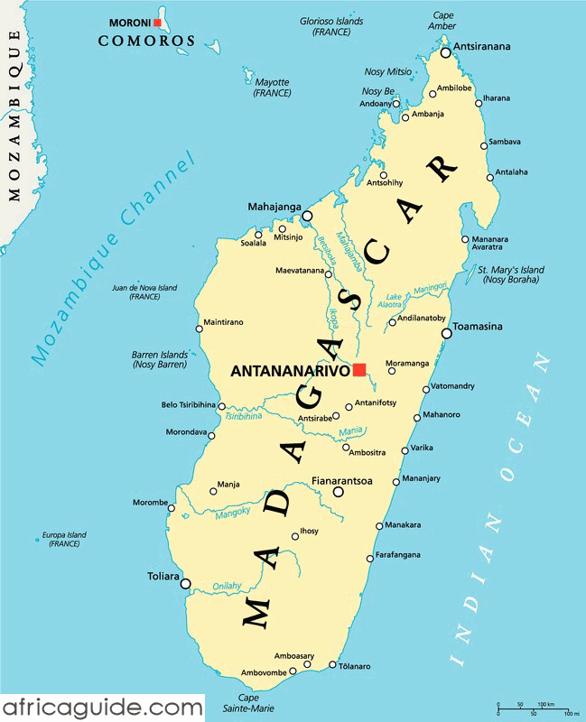
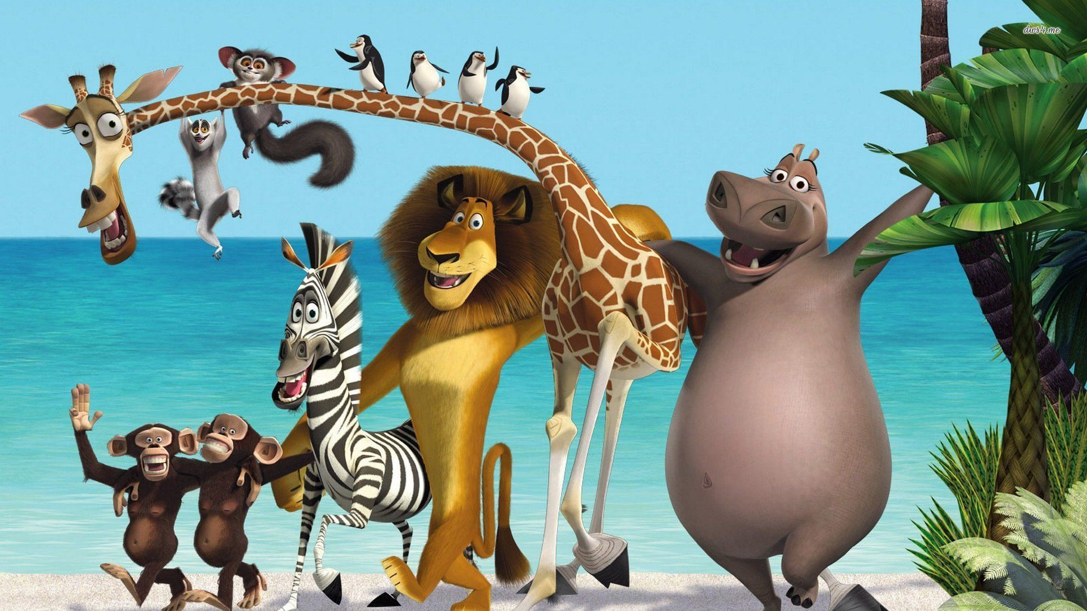
Did you guys meet ? ^.^ you are all in…

